Slide 1
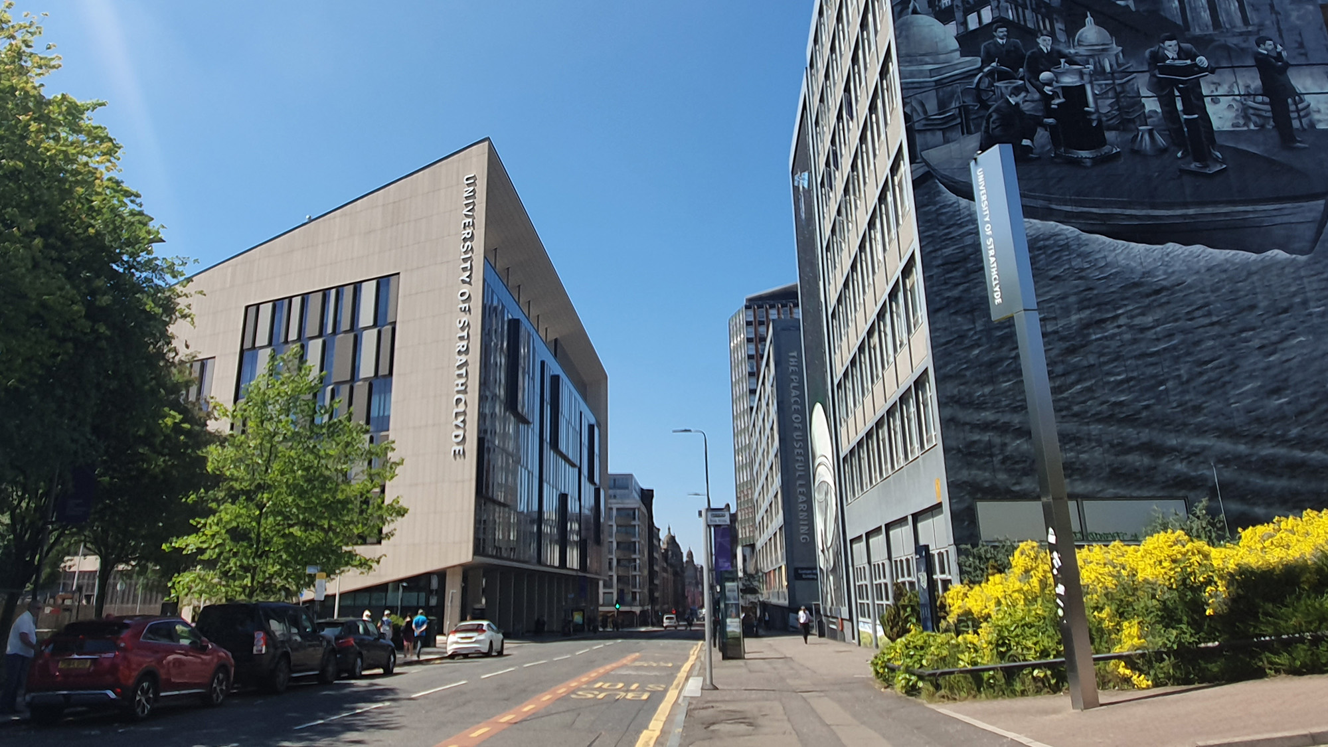

Module Introduction
Sampling and Quantization
carmine.clemente@strath.ac.uk

Slide 2
Introduction
We said that, under certain conditions, representations continuous and discrete of signals can be assumed to be equivalent;
We want to identify what are these conditions (hypothesis), and we will see how a continuous signal can be reconstructed starting from its sampled version;
We will see how the decimation process can be used to revert a discrete signal to a given sampling frequency;
We will also introduce the A/D and D/A conversion, including the quantization process.

Slide 3
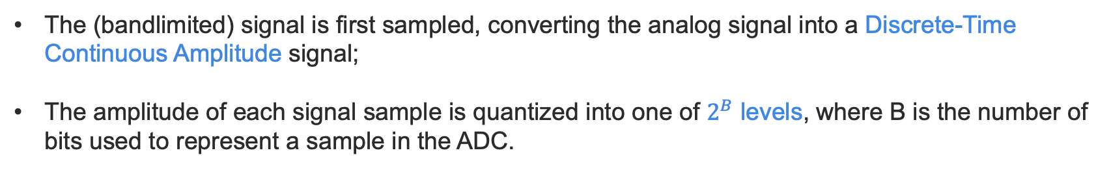
Basic DSP Systems
T (seconds)
Reconstruction Sampling Interval
T (seconds)
Sampling Interval
B+1
(# of bits)
x_{Q}(nT)
or
x_{Q}[n]
y(nT)
or
y[n]
x(t)
Sample & Hold
x_{s} (t)
y(t)
Quantiser
DSP
DAC
ADC
CT-CA
DT-CA
DT-DA
CT-CA
The (bandlimited) signal is first sampled, converting the analog signal into a Discrete-Time Continuous Amplitude signal;
The amplitude of each signal sample is quantized into one of $2^{B}$ levels, where B is the number of bits used to represent a sample in the ADC.

Slide 4
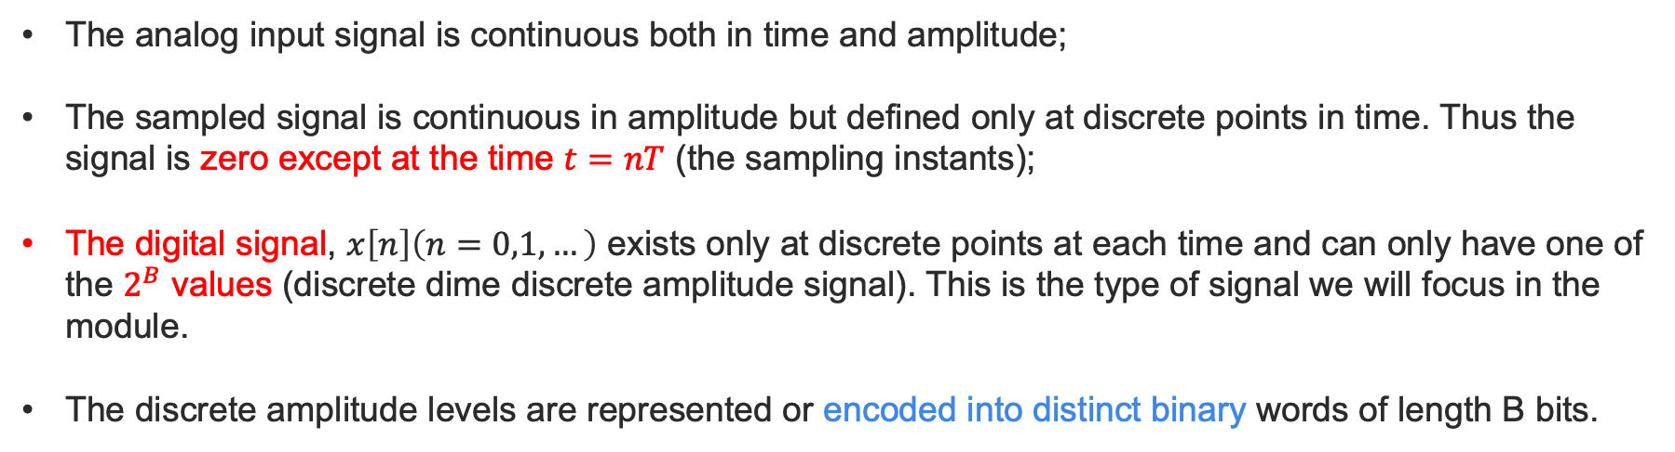
Analog to digital conversion
Low Pass Filter
Sample & Hold
Quantizer
Encoder
Logic Circuit
…
Fs
1
The analog input signal is continuous both in time and amplitude;
The sampled signal is continuous in amplitude but defined only at discrete points in time. Thus the signal is zero except at the time $t=nT$ (the sampling instants);
The digital signal, $x\left[n\right]\left(n=0,1, …\right)$ exists only at discrete points at each time and can only have one of the $2^{B}$ values (discrete dime discrete amplitude signal). This is the type of signal we will focus in the module.
The discrete amplitude levels are represented or encoded into distinct binary words of length B bits.

Slide 5
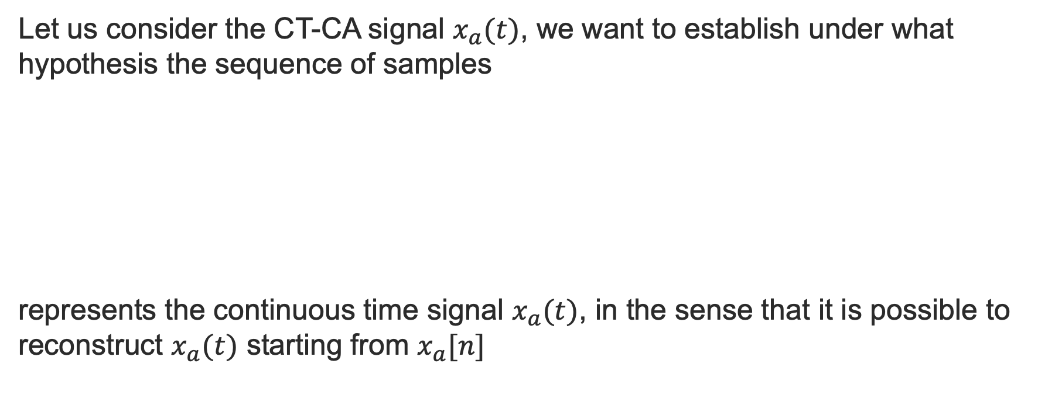
Sampling
Let us consider the CT-CA signal $x_{a}(t)$, we want to establish under what hypothesis the sequence of samples
represents the continuous time signal $x_{a}(t)$, in the sense that it is possible to reconstruct $x_{a}(t)$ starting from $x_{a}[n]$

Slide 6
Sampling
It is convenient to represent the sampling process mathematically in two stages, an impulse train modulator followed by the conversion of the impulse train to a sequence.
Impulse train
Sifting Property

Slide 7

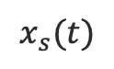
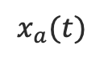
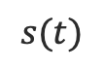
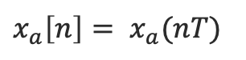
Sampling
Thanks to the Sifting Property we can write:
$$s(t)$$
Mathematical representation only!
Conversion from impulse train to discrete-time sequence
$$x_{a}(t)$$
$$x_{s}(t)$$
$x_{a}\left[n\right]= x_{a}(nT)$
Converting it into a sequence, means extracting $x_{a}\left[n\right]= x_{a}(nT)$

Slide 8
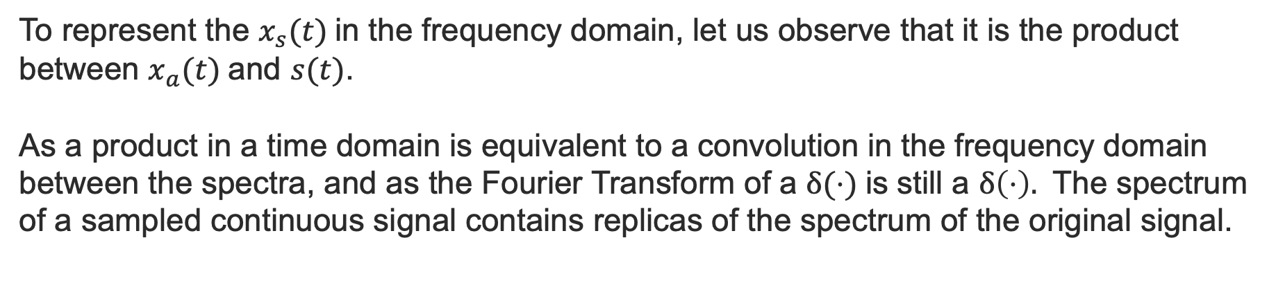
Sampling – Frequency domain
To represent the $x_{s}(t)$in the frequency domain, let us observe that it is the product between $x_{a}(t)$and $s(t)$.
As a product in a time domain is equivalent to a convolution in the frequency domain between the spectra, and as the Fourier Transform of a $δ(⋅)$is still a $δ\left(⋅\right).$ The spectrum of a sampled continuous signal contains replicas of the spectrum of the original signal.

Slide 9
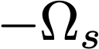
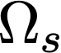
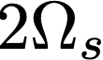
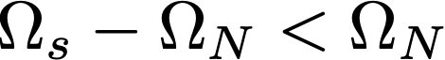
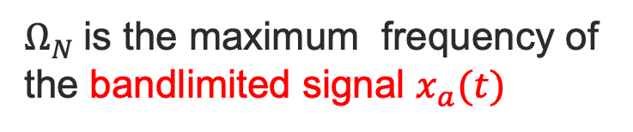
Sampling – Frequency domain
$Ω_{N}$is the maximum frequency of the bandlimited signal $x_{a}(t)$
(A)
(B)
Replicas overlap – Add Up - Aliasing

Slide 10
Sampling – Signal Representation
In order to be able to reconstruct the original signal, the replicas need to be separated, so according to (A)
So if this condition is respected, it is possible to apply a lowpass filter to remove the replicas and reconstruct the original sequence

Slide 11
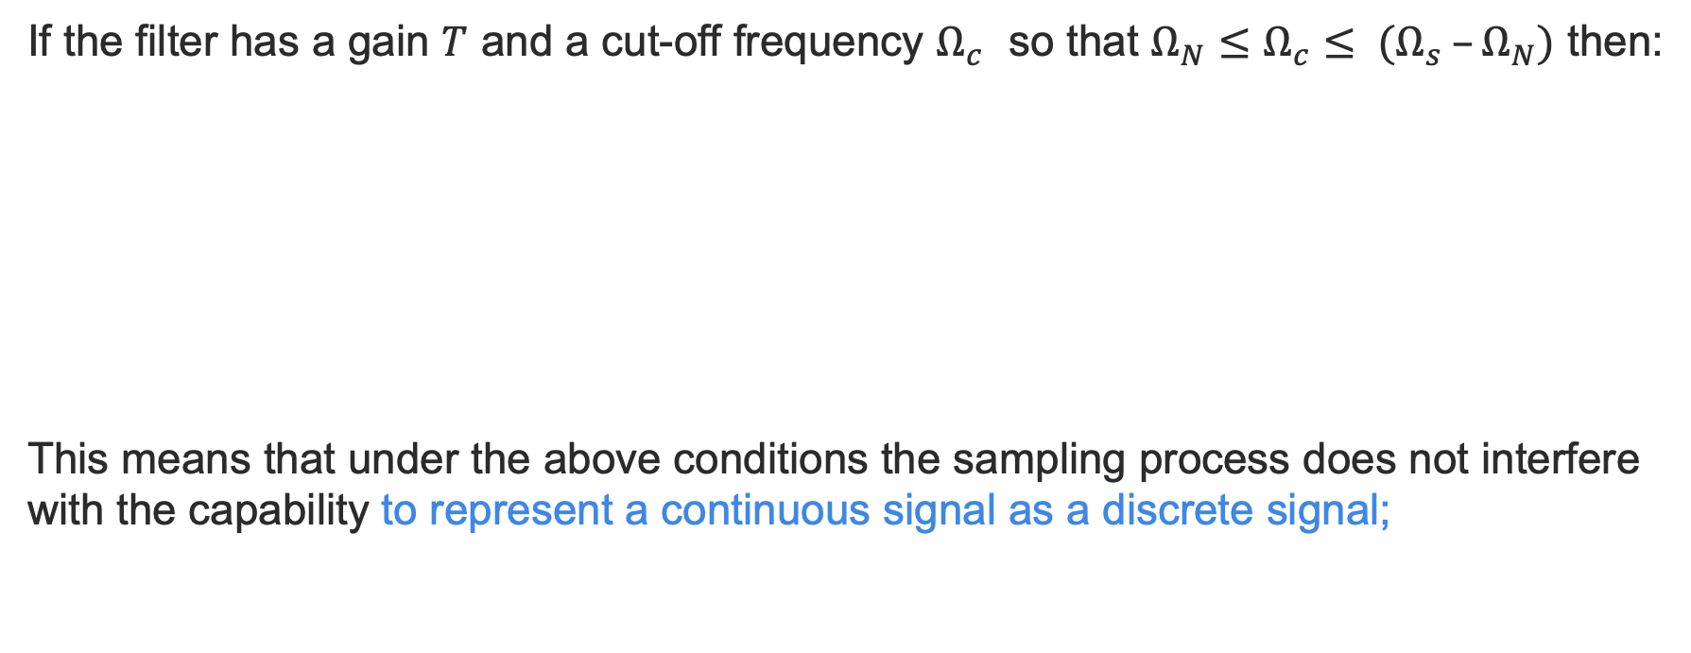
Sampling – Signal Representation
If the filter has a gain $T$ and a cut-off frequency $Ω_{c}$ so that $Ω_{N}≤Ω_{c}≤ (Ω_{s} –Ω_{N})$ then:
This means that under the above conditions the sampling process does not interfere with the capability to represent a continuous signal as a discrete signal;

Slide 12
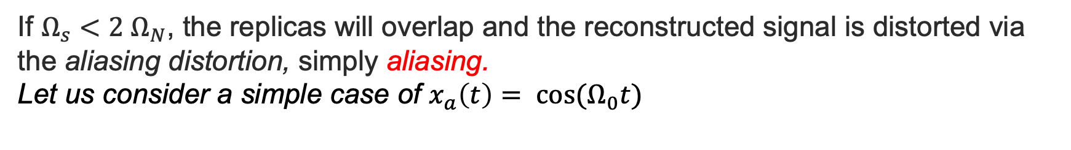
Sampling – Aliasing
If $Ω_{s}<2 Ω_{N}$, the replicas will overlap and the reconstructed signal is distorted via the aliasing distortion, simply aliasing.
Let us consider a simple case of $x_{a}\left(t\right)= cos⁡(Ω_{0}t)$
No overlap
(A)
Aliased components.
We see components that do not exist!
(B)

Slide 13
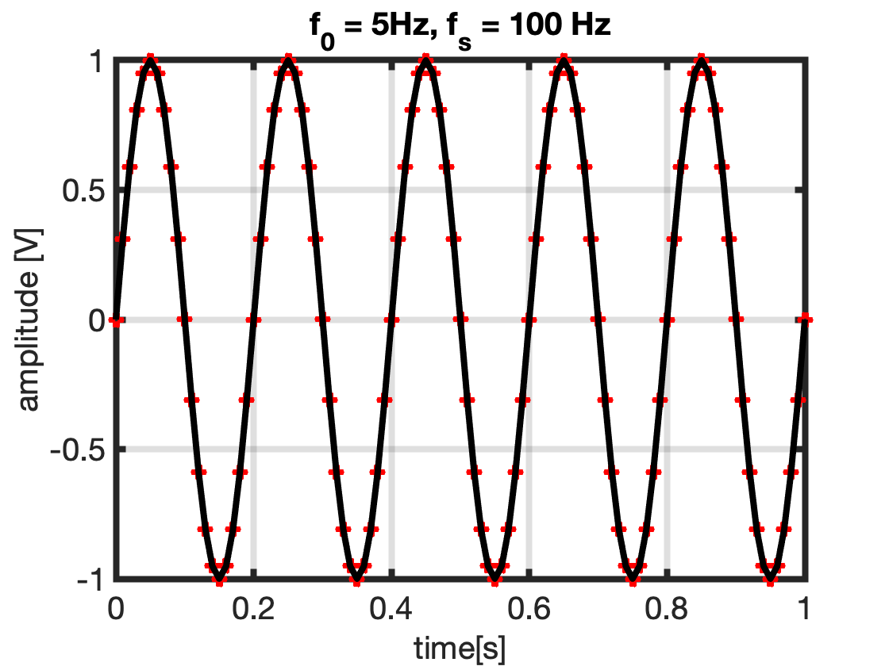
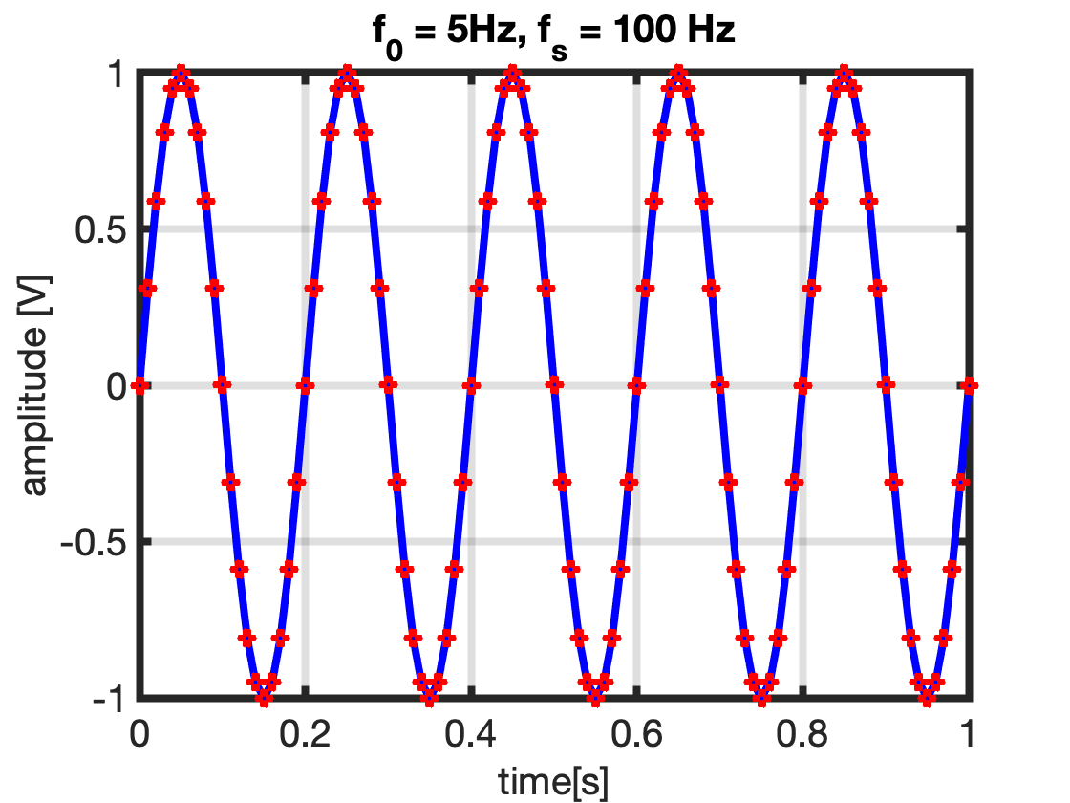
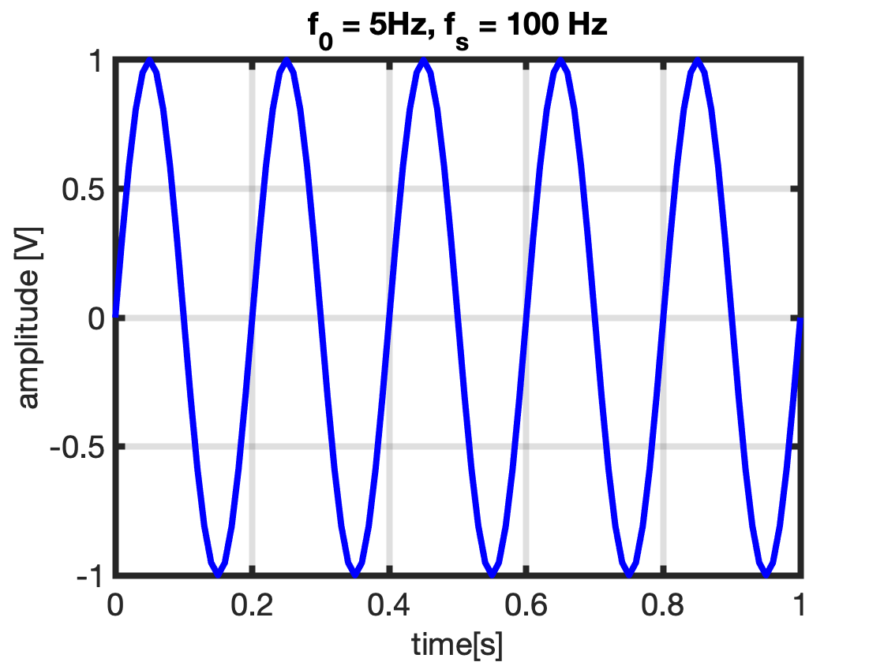
Sampling – Proper Sampling

Slide 14
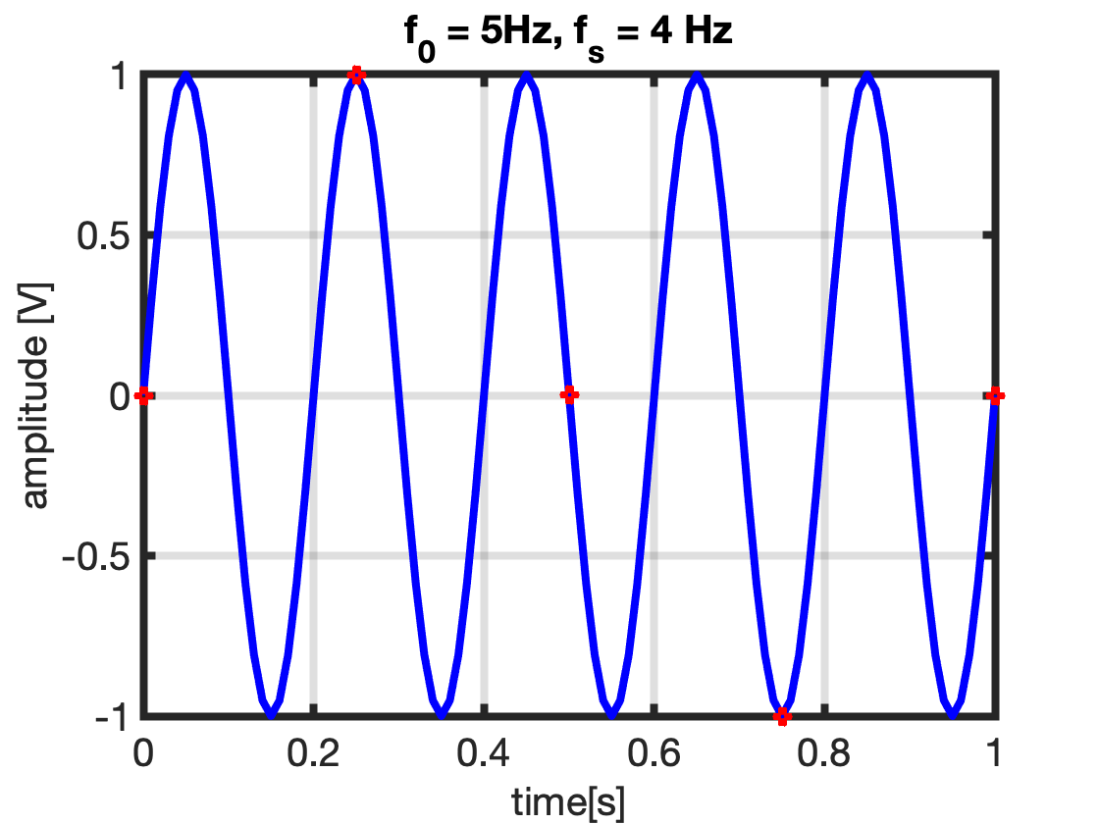
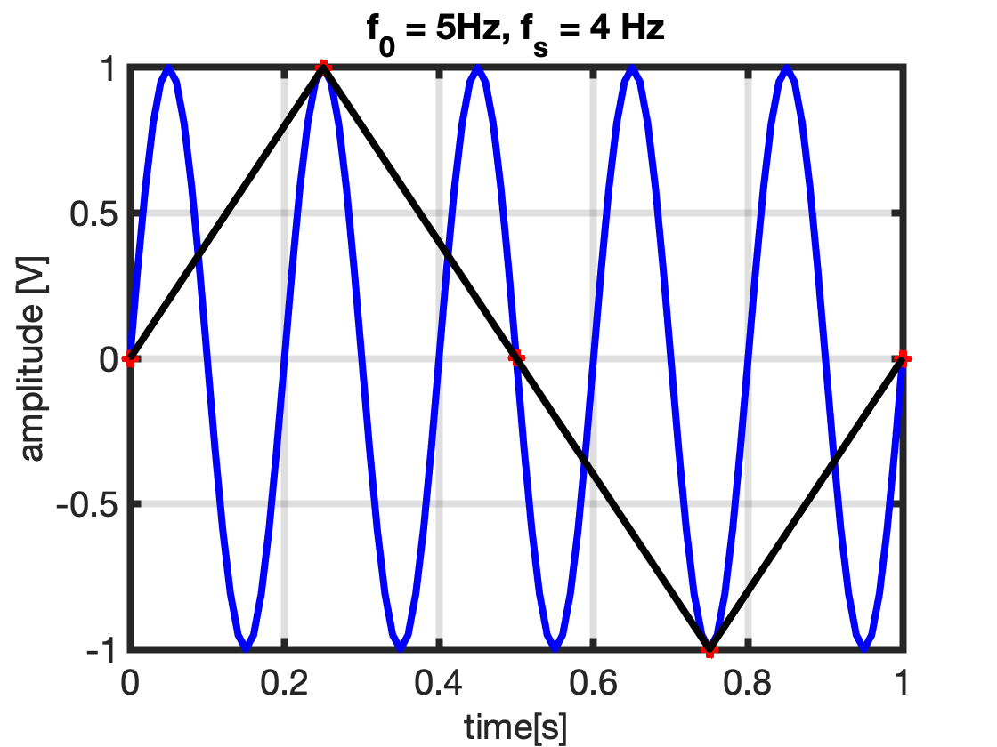
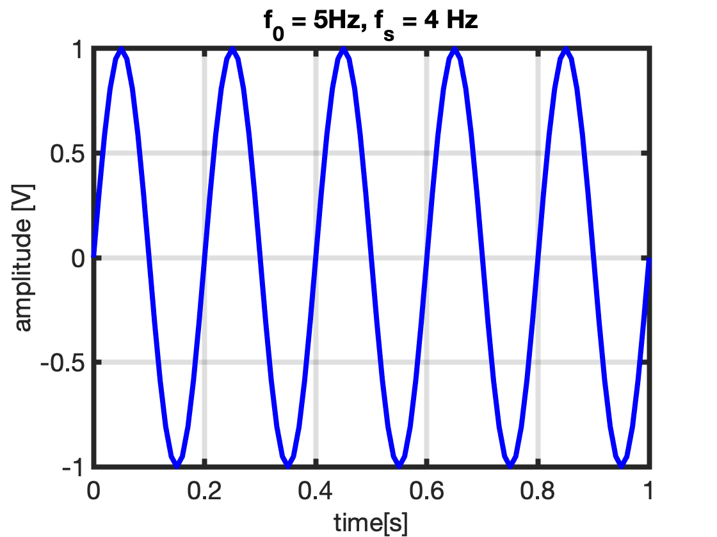
Sampling – Improper Sampling

Slide 15

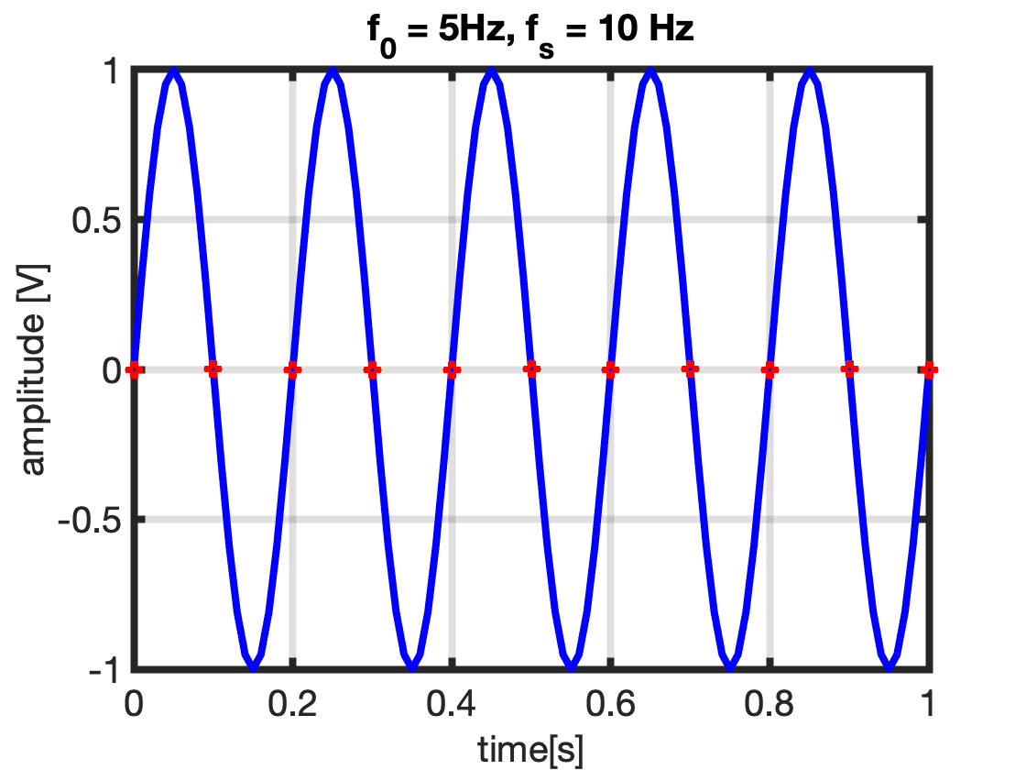
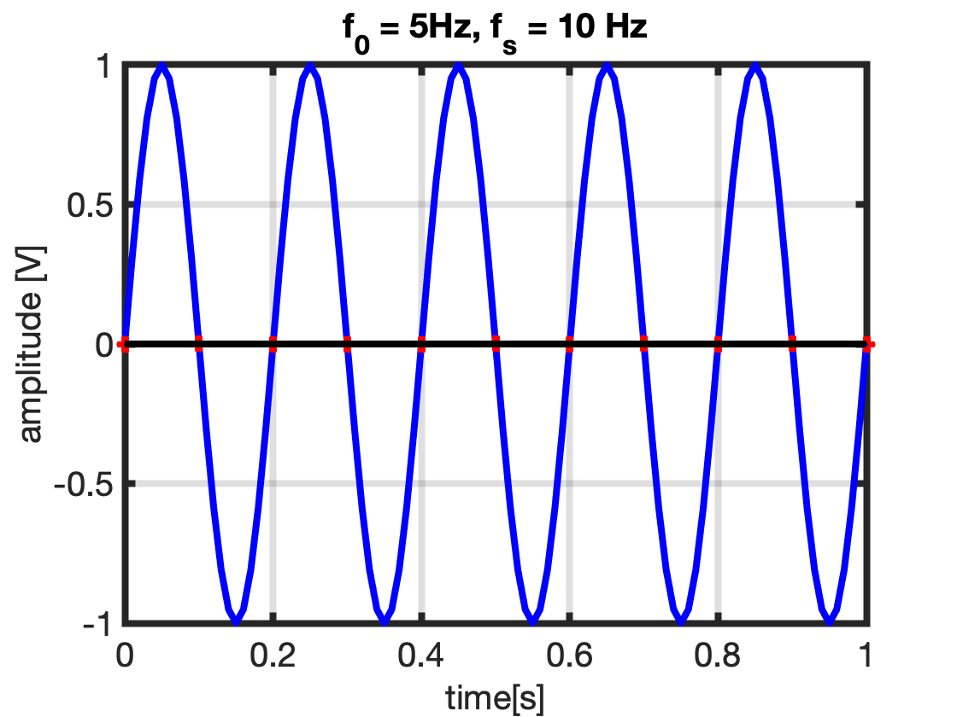
Sampling – Border-line Sampling

Slide 16
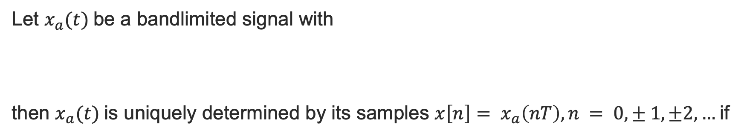
Nyquist-Shannon Sampling Theorem
Let $x_{a}(t)$be a bandlimited signal with
then $x_{a}(t)$is uniquely determined by its samples $x\left[n\right]= x_{a}\left(nT\right), n = 0,± 1, ±2, …$if
$Ω_{N}$is called Nyquist Frequency (maximum frequency sampled correctly with certain rate) and $2Ω_{N}$ is the Nyquist Rate.

Slide 17
Class Activity: Part 1
Draw four cycles of a 100Hz cosine waveform x(t) (a continuous signal)
This cosine is to be sampled :
Question 1 : How many samples per period(cycle) of x(t) would you use to adequately sample the cosine ?
Question 2 : What is the minimum number of samples per period of x(t) required to adequately sample the cosine ?

Slide 18
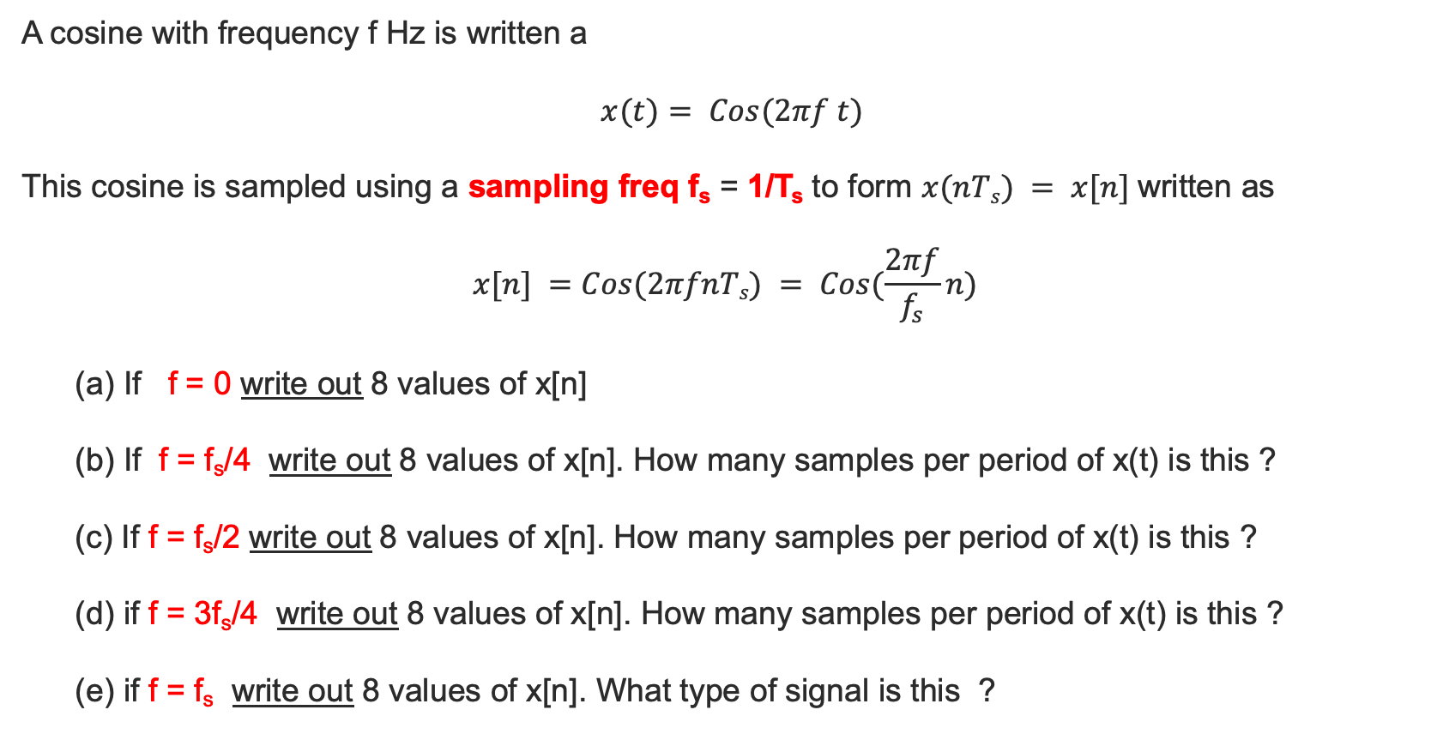
Class Activity: Part 2
A cosine with frequency f Hz is written a
$$x(t)= Cos(2πf t)$$
This cosine is sampled using a sampling freq f_{s} = 1/T_{s} to form $x(nTs) = x[n]$written as
$$x[n] =Cos(2πfnTs) = Cos(\frac{2πf}{f_{s}}n)$$
(a) If f = 0 write out 8 values of x[n]
(b) If f = f_{s}/4 write out 8 values of x[n]. How many samples per period of x(t) is this ?
(c) If f = f_{s}/2 write out 8 values of x[n]. How many samples per period of x(t) is this ?
(d) if f = 3f_{s}/4 write out 8 values of x[n]. How many samples per period of x(t) is this ?
(e) if f = f_{s} write out 8 values of x[n]. What type of signal is this ?

Slide 19
Class Activity: Part 2
f_{s} fixed
f=0 Hz x[n]=cos(2π(0) n) = { 1 1 1 1 1 1 1 1 …} A dc signal
f = fs/4 Hz x[n]= cos(2π(f_{s}/4f_{s}) n) =cos(πn/2)= { 1 0 -1 0 1 0 -1 0 ..}
(c) f = fs/2 Hz x[n]= cos(2π(f_{s}/2f_{s}) n)= cos(πn) = { 1 -1 1 -1 1 -1 1 -1 ..}
(d) f = 3fs/4 Hz
x[n]= cos(2π(f_{s}/f_{s}) n)=cos(3π n/2) = {1 0 -1 0 1 0 -1 0..}
(e) f = fs Hz
x[n]= cos(2π n) = { 1 1 1 1 1 1 1 1 ..}
A dc signal (identical to (a) although continuous. Signal (e) is not a DC signal.)

Slide 20
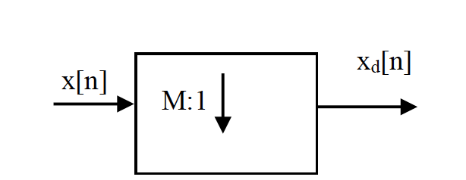

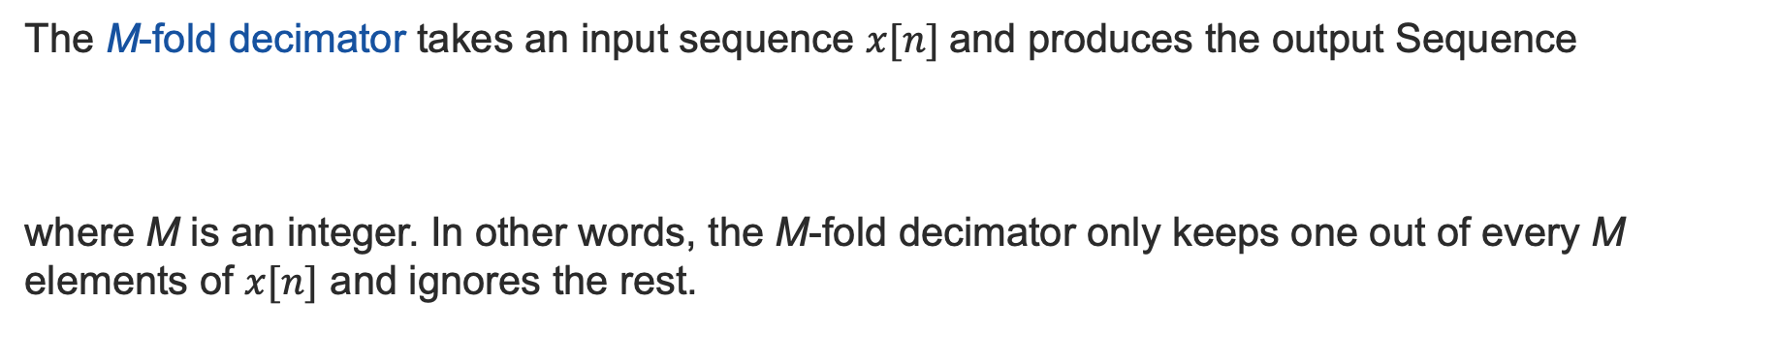
Decimation/Downsampling
The M-fold decimator takes an input sequence $x[n]$and produces the output Sequence
where M is an integer. In other words, the M-fold decimator only keeps one out of every M elements of $x[n]$ and ignores the rest.
$$x_{d\left[n\right]}=x[Mn]$$
M
Note: in order to avoid aliasing, the new sampling frequency after decimation should still obey to the Nyquist-Shannon sampling rate.

Slide 21
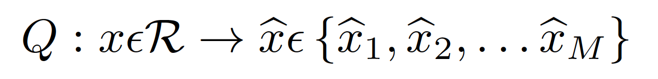
Quantization
Low Pass Filter
Sample & Hold
Quantizer
Encoder
Logic Circuit
…
Fs
1
We have seen what is the sampling process doing, let us now see how the Quantizer operates.
The quantization process represents the samples with a finite number of digits (usually binary).
The memoryless quantization is the process:

Slide 22
Quantization
Quantization is carried out by discretizing the signal with a number of quantization levels. The Quantizer takes the sample value and represents it with the closest binary number it can use.
The number of binary levels is determined by the number of bits used to represent each sample. Quantising a sampled signal will lead to losses. This is known as quantisation error. Obviously increasing the number of discrete levels (increasing the number of bits) available will offer a better match to the sample value with a resulting lower quantisation error.
Both sampling and quantization result in the loss of information. The quality of a Quantizer output depends upon the number of quantization levels used. The discrete amplitudes of the quantized output are called as quantisation levels. The spacing between the two adjacent representation levels is called a quantum or step-size.

Slide 23
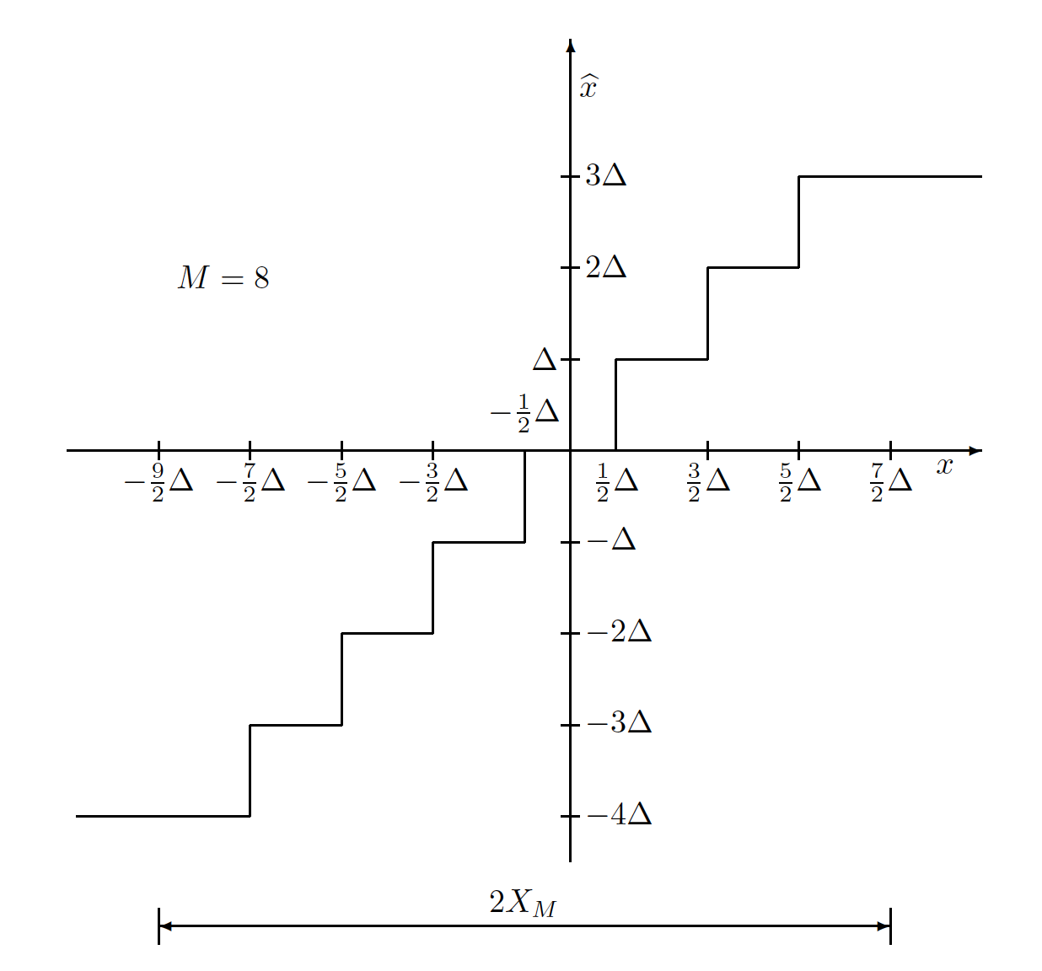
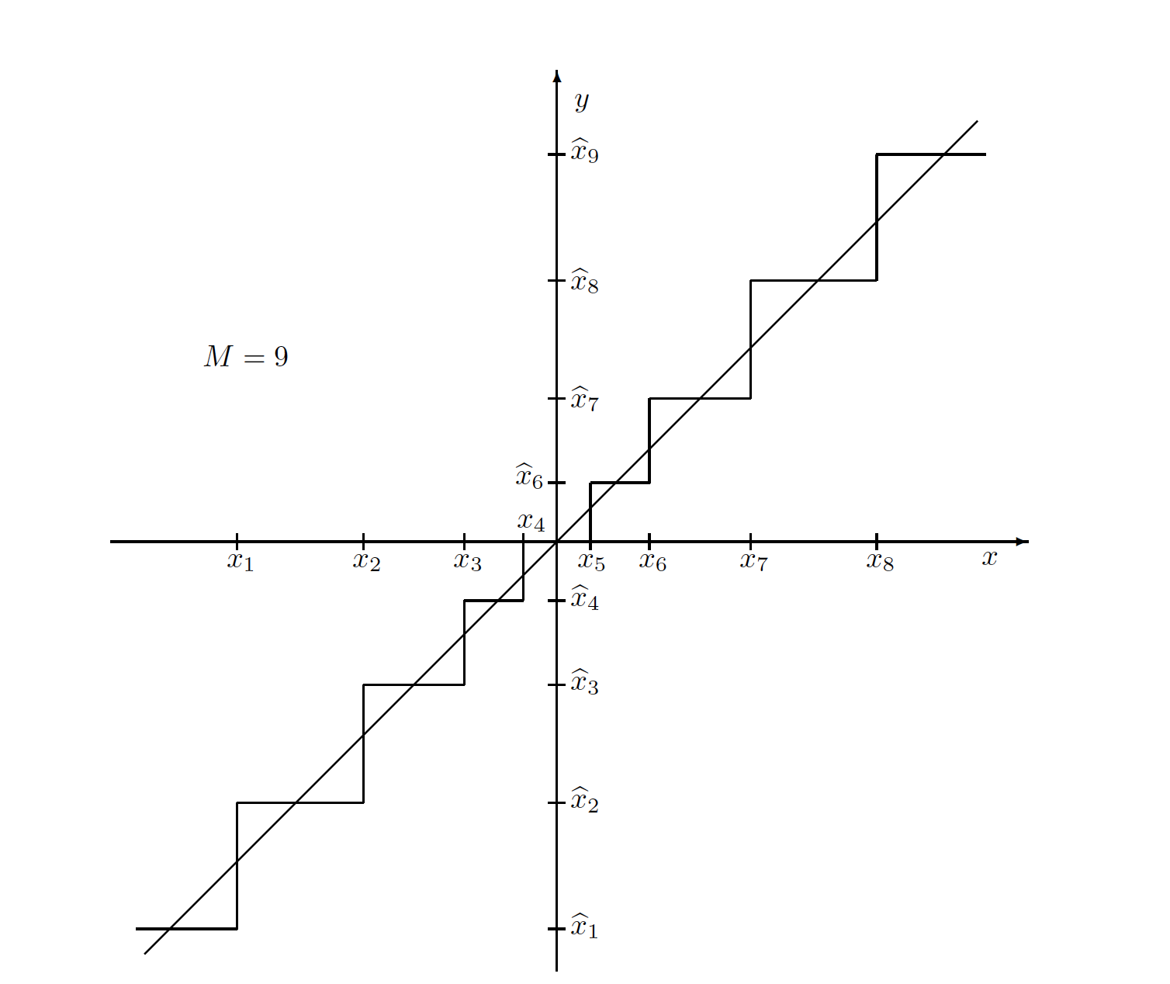
Quantization
The type of quantization in which the quantization levels are uniformly spaced is termed as a Uniform Quantization.
The type of quantization in which the quantization levels are unequal and mostly the relation between them is logarithmic, is termed as a Non-uniform Quantization.
Uniform quantizer
Non - Uniform quantizer

Slide 24
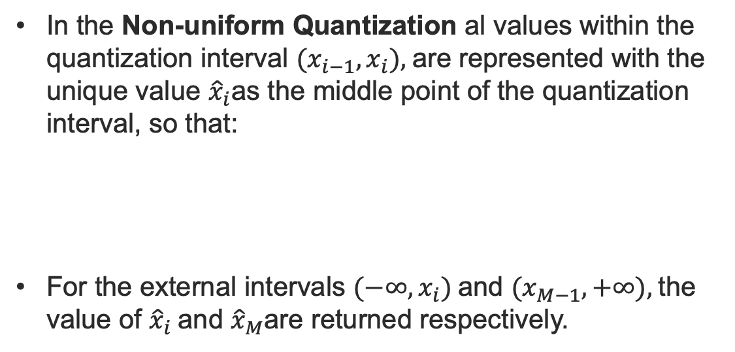
Quantization
Non - Uniform quantizer
In the Non-uniform Quantization al values within the quantization interval $(x_{i−1}, x_{i}),$are represented with the unique value ${\hat{x}}_{i}$as the middle point of the quantization interval, so that:
For the external intervals $(−∞, x_{i})$and $(x_{M−1}, +∞),$the value of ${\hat{x}}_{i}$and ${\hat{x}}_{M}$are returned respectively.

Slide 25
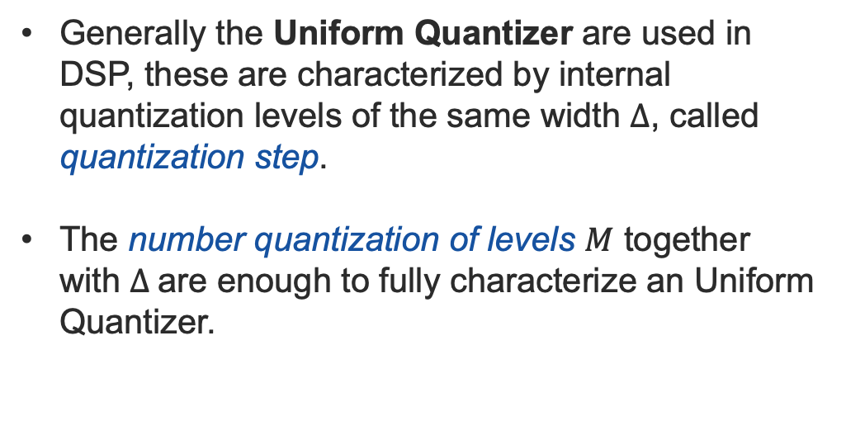
Quantization
Uniform quantizer
Generally the Uniform Quantizer are used in DSP, these are characterized by internal quantization levels of the same width $Δ$, called quantization step.
The number quantization of levels $M$ together with $Δ$are enough to fully characterize an Uniform Quantizer.

Slide 26
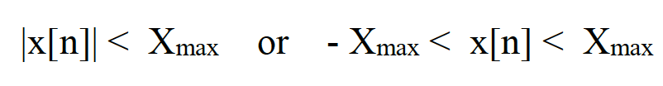
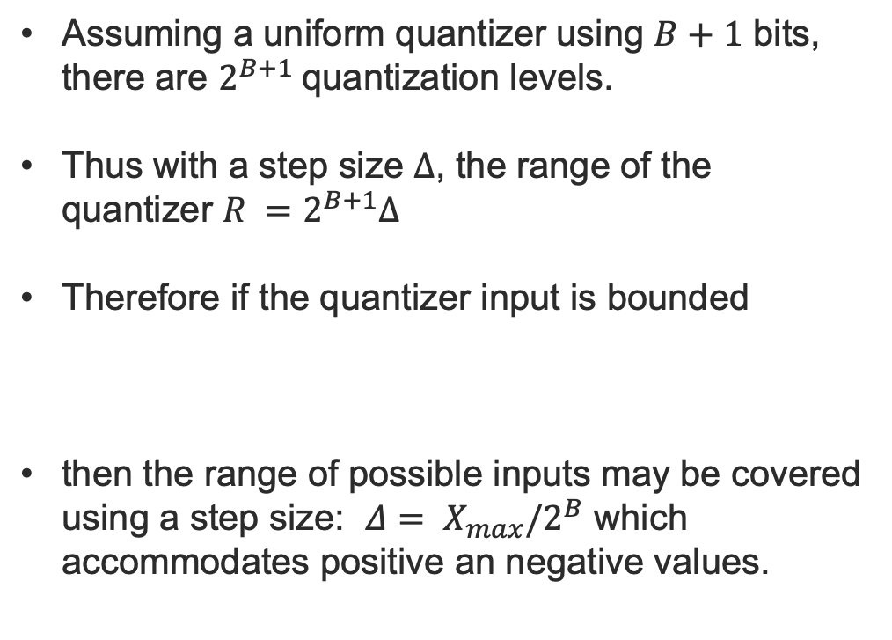
Quantization
Uniform quantizer
Assuming a uniform quantizer using $B+1$ bits, there are $2^{B+1}$quantization levels.
Thus with a step size $Δ$, the range of the quantizer $R =2^{B+1}Δ$
Therefore if the quantizer input is bounded
then the range of possible inputs may be covered using a step size: $Δ= X_{max}/2^{B}$ which accommodates positive an negative values.

Slide 27
Quantization
Two’s-complement code
Offset binary code
011
010
001
000
111
110
101
100
111
110
101
100
011
010
001
000

Slide 28
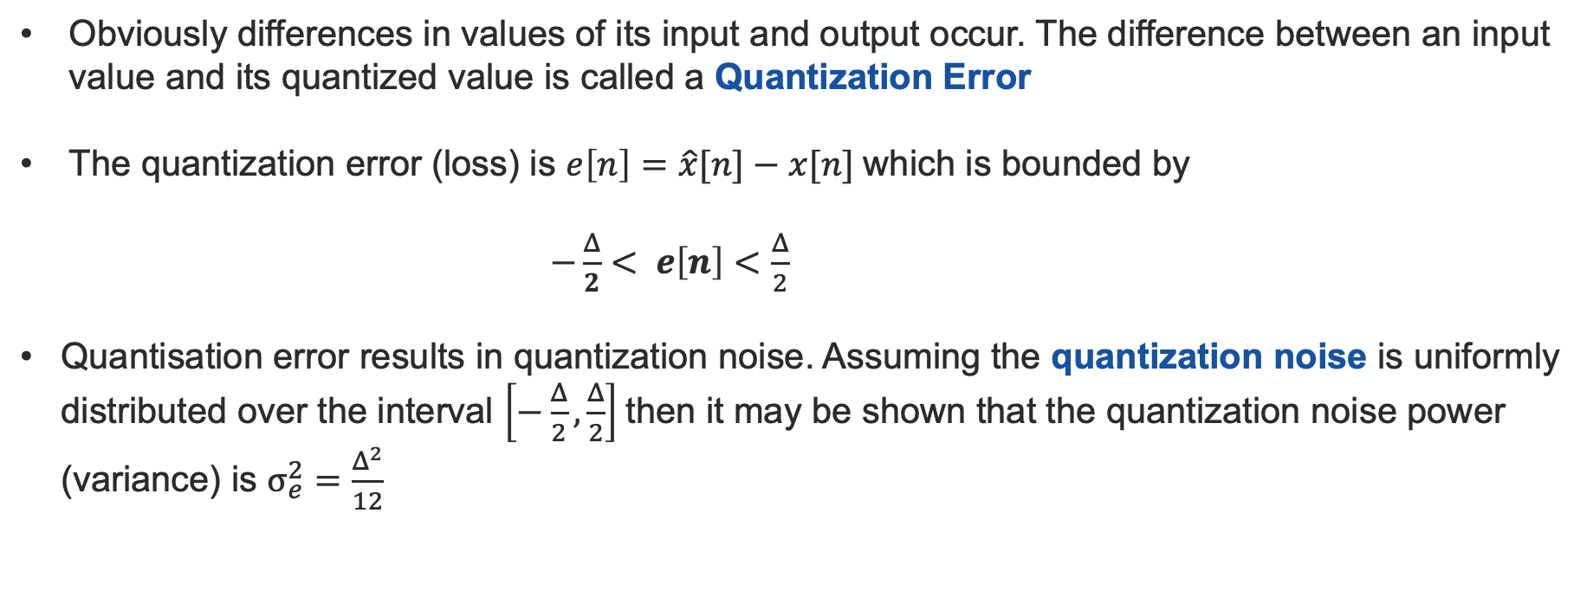
Quantization - error
Obviously differences in values of its input and output occur. The difference between an input value and its quantized value is called a Quantization Error
The quantization error (loss) is $e\left[n\right]=\hat{x}[n]−x[n]$which is bounded by
$−\frac{Δ}{2}< e\left[n\right]<\frac{Δ}{2}$
Quantisation error results in quantization noise. Assuming the quantization noise is uniformly distributed over the interval $\left[−\frac{Δ}{2},\frac{Δ}{2}\right]$then it may be shown that the quantization noise power (variance) is $σ_{e}^{2}=\frac{Δ^{2}}{12}$

Slide 29
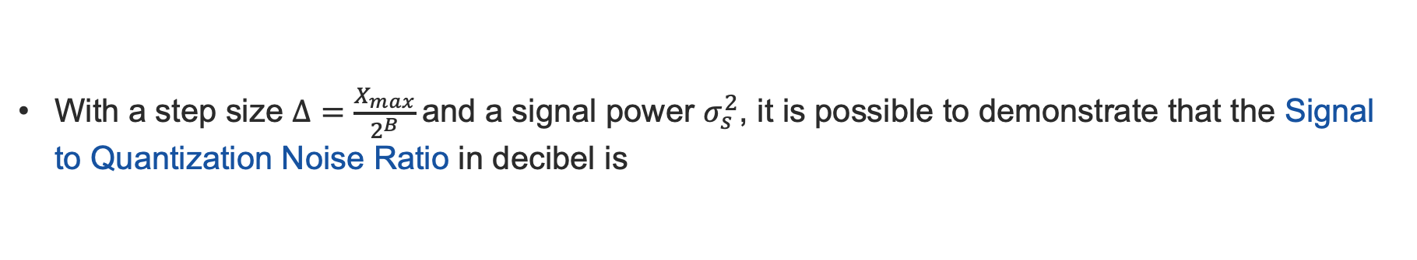
Quantization - SQNR
With a step size $Δ=\frac{X_{max}}{2^{B}}$ and a signal power $σ_{s}^{2}$, it is possible to demonstrate that the Signal to Quantization Noise Ratio in decibel is
Thus the SQNR increases approximately 6dB for each additional bit.

Slide 30
Quantization - exercise
A full period of a sinusoid with amplitude 2 is sampled with 8 samples. Assuming that the first sample is taken when the value is 0, sketch the sampling and quantization process and write the sequence after sampling and after quantization (M = 8, 3 bits, offset binary quantizer) .

Slide 31
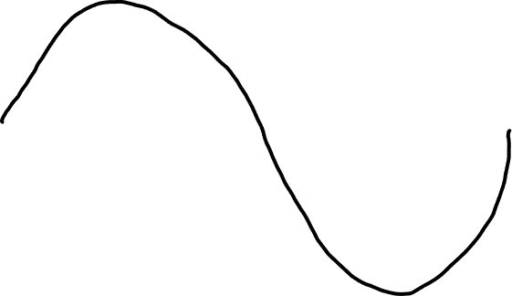
Quantization - exercise

Slide 32
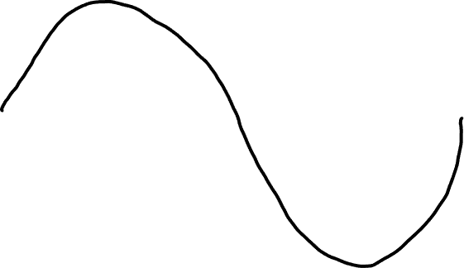
Quantization - exercise

Slide 33





Quantization - exercise

Slide 34
Quantization - exercise

Slide 35
Module Introduction
Signal Reconstruction
carmine.clemente@strath.ac.uk

Slide 36
Digital to Analog Conversion
T (seconds)
Reconstruction Sampling Interval
T (seconds)
Sampling Interval
B+1
(# of bits)
x_{Q}(nT)
or
x_{Q}[n]
y(nT)
or
y[n]
x(t)
Sample & Hold
x_{s} (t)
y(t)
Quantiser
DSP
DAC
ADC
CT-CA
DT-CA
DT-DA
CT-CA
The sampling process produces a discrete time signal from a continuous time signal by examining the value of the continuous time signal at equally spaced points in time.
Reconstruction, also known as interpolation, attempts to perform an opposite process that produces a continuous time signal coinciding with the points of the discrete time signal.
Note: the sampling process for general sets of signals is not invertible, so there are numerous possible reconstructions from a given discrete time signal.

Slide 37
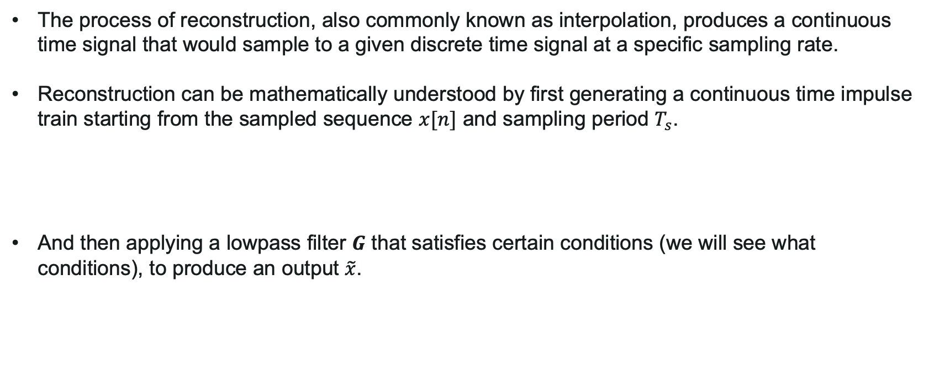
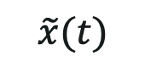
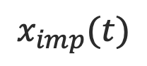
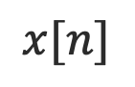
Signal Reconstruction
The process of reconstruction, also commonly known as interpolation, produces a continuous time signal that would sample to a given discrete time signal at a specific sampling rate.
Reconstruction can be mathematically understood by first generating a continuous time impulse train starting from the sampled sequence $x[n]$ and sampling period $T_{s}$.
And then applying a lowpass filter $G$ that satisfies certain conditions (we will see what conditions), to produce an output $\tilde{x}$.
Impulse train
G
$$x[n]$$
$$x_{imp}(t)$$
$$\tilde{x}(t)$$
LPF

Slide 38
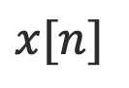
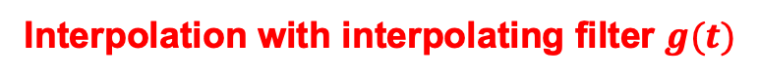
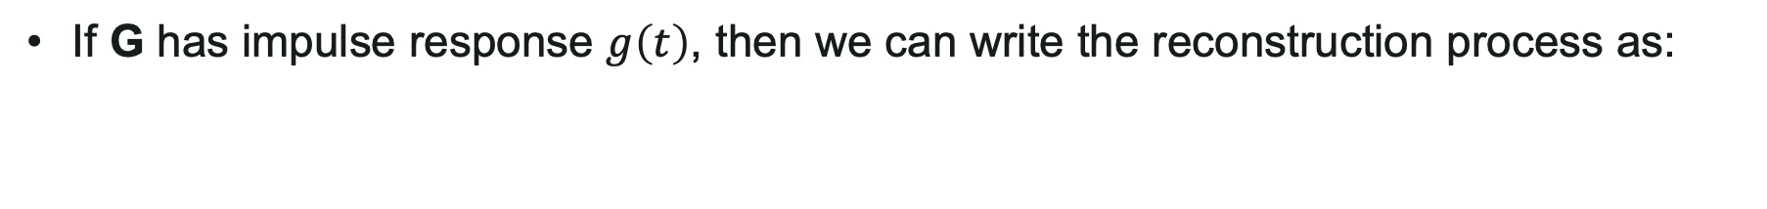
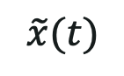
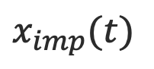
Signal Reconstruction
Impulse train
G
$$x[n]$$
$$x_{imp}(t)$$
$$\tilde{x}(t)$$
LPF
If G has impulse response $g\left(t\right)$, then we can write the reconstruction process as:
Interpolation with interpolating filter $g(t)$

Slide 39
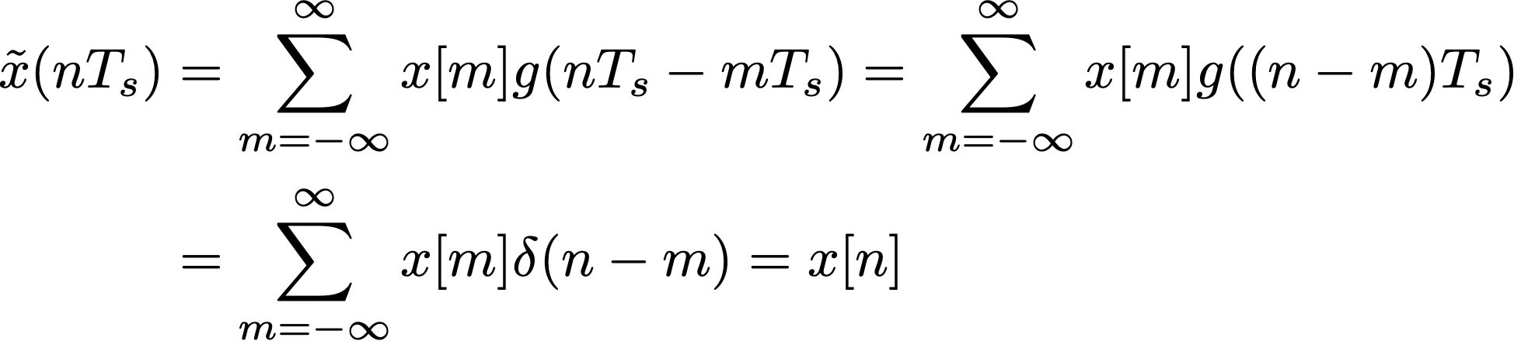
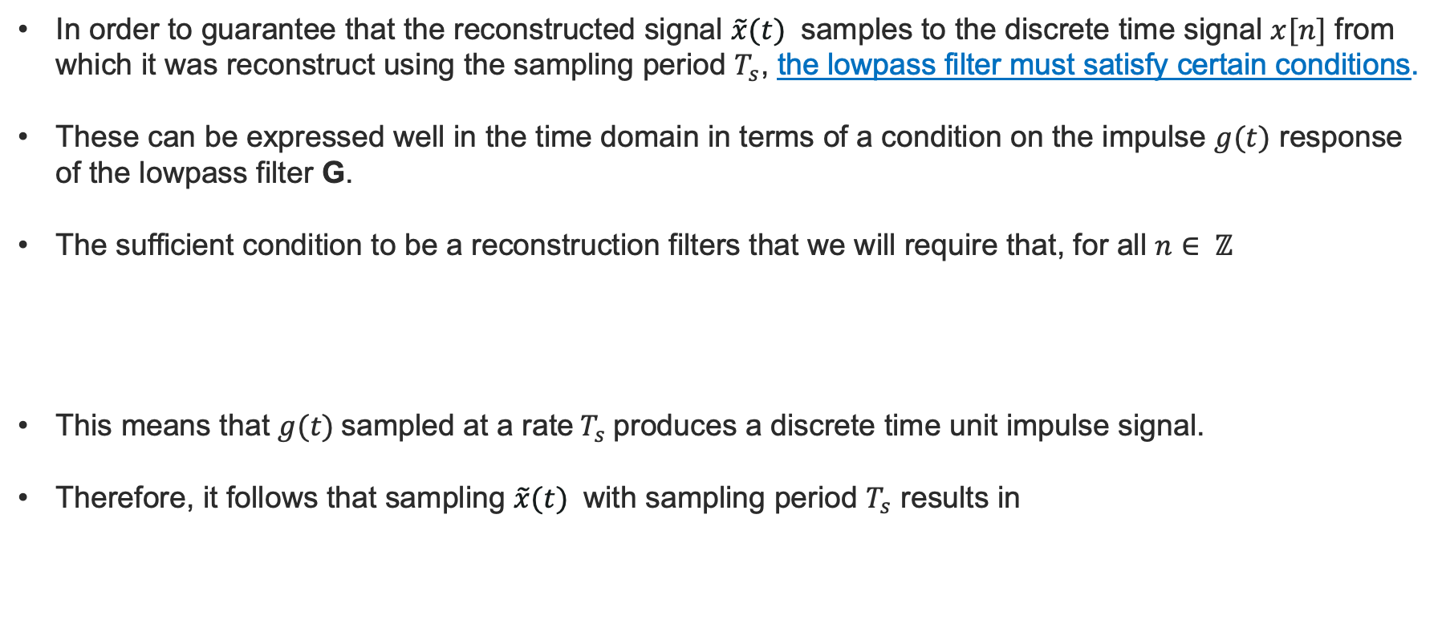

Reconstruction Filters
In order to guarantee that the reconstructed signal $\tilde{x}(t)$ samples to the discrete time signal $x[n]$ from which it was reconstruct using the sampling period $T_{s}$, the lowpass filter must satisfy certain conditions.
These can be expressed well in the time domain in terms of a condition on the impulse $g(t)$ response of the lowpass filter G.
The sufficient condition to be a reconstruction filters that we will require that, for all $n∈ ℤ$
This means that $g(t)$sampled at a rate${ T}_{s}$produces a discrete time unit impulse signal.
Therefore, it follows that sampling $\tilde{x}(t)$ with sampling period $T_{s}$ results in
The desired reconstruction equality shown in previous slide
Multiple Integer of $T_{s}$

Slide 40
Basis Splines
Since there are many continuous time signals that sample to a given discrete time signal, additional constraints are required in order to identify a particular one of these.
For instance, we might require our reconstruction to yield a spline of a certain degree, which is a signal described in piecewise parts by polynomials not exceeding that degree.
Additionally, we might want to guarantee that the function and a certain number of its derivatives are continuous.
An approach is to restrict the span of sets of certain splines, called basis splines or B-splines.

Slide 41




Basis Splines
If a $n^{th}$ degree spline with continuous derivatives up to alt least order $n−1$ is required, then the desired function belongs to the span $\{B_{n} (\frac{t}{T_{s}}−k)|k∈ ℤ\}$, where for $n≥1$ we have
Not 1 in 0! So not reconstruction filters!

Slide 42


Cardinal Basis Splines
Even if $B_n$ for $n≥ 2$are not reconstruction filters, we can use them to define the cardinal basis splines which do satisfy the reconstruction filter conditions.
If we let $b_{n}$ be the samples of $B_{n}$ on the integers, it turns out that has an inverse $b_{n}^{−1}$with respect to the operation of convolution for each $n$. Or specifically: $b_{n}∗b_{n}^{−1}=δ$.
The cardinal basis spline of order $n$for reconstruction with sampling period $T_{s}$is defined as

Slide 43


Cardinal Basis Splines
In order to confirm that a cardinal basis spline is a reconstruction filter let us consider the following:
As $η_{n}$ is a spline with continuous derivatives up to order $n−1$, also the result of the reconstruction will be a spline with continuous derivatives up to order $n−1$
So it is a valid reconstruction filter

Slide 44

Cardinal Basis Splines
Satisfy the conditions to be reconstruction filters;
As $n$ grows they start approximating the $sinc$ function ($η_{∞}$is the $sinc$ function);
Using the $n−$th order cardinal basis spline $η_{n}$, the result is a piecewise degree $n$polynomial. Furthermore, it has continuous derivatives up to at least order $n−1$. However, unless all samples are points on a polynomial of degree at most $n$, the derivative of order $n$ will be discontinuous.

Slide 45
Cardinal Basis Splines
Sampled
Reconstructed

Slide 46

Perfect Reconstruction
If certain additional assumptions about the original signal and sampling rate hold, then the original signal can be recovered exactly from its samples using a particularly important type of filter.
If a bandlimited signal is sampled at a rate greater than twice its bandlimit, the Whittaker-Shannon reconstruction formula perfectly reconstructs the original signal.
This formula makes use of the ideal lowpass filter, which is related to the $sinc$ function.
This is extremely useful, as sampled versions of continuous time signals can be filtered using discrete time signal processing, often in a computer.
The results may then be reconstructed to produce the same continuous time output as some desired continuous time system.

Slide 47





Perfect Reconstruction
The ideal filter in the frequency domain removes all the signal content outside the signal’s bandwidth
$$G(ω)$$
$$X_{s}(ω)$$
$$\frac{1}{T_{s}}$$
$$−\frac{f_{s}}{2}$$
$$\frac{f_{s}}{2}$$

Slide 48



Perfect Reconstruction
The inverse Fourier Transform of $G(ω)$is
And hence
it is a valid reconstruction filter

Slide 49

Whittaker-Shannon interpolation formula
We can always reconstruct a bandlimited signal with sampling period $T_{s}$from its samples by using:
This perfect reconstruction formula is known as the Whittaker-Shannon interpolation formula and is sometimes also called the cardinal series (as it uses the cardinal basis spline $η_{∞}$).

Slide 50

Reconstruction summary
Bandlimited continuous time signals can be reconstructed exactly from their samples provided that the sampling rate exceeds the Nyquist rate, which is twice the bandlimit.
The Whittaker-Shannon reconstruction formula computes this perfect reconstruction using an ideal lowpass filter, with the resulting signal being a sum of shifted $sinc$ functions that are scaled by the sample values.
Sampling below the Nyquist rate can lead to aliasing which makes the original signal irrecoverable
The ability to perfectly reconstruct bandlimited signals has important practical implications for the processing of continuous time signals using the tools of discrete time signal processing.

